Slide 1
Artificial Intelligence
6 – Permanent Evaluation Challenge

Slide 2

Kaggle Competition Challenge (Private Classroom Challenge)
Team of 3 students
Choose your own team during lesson 1
No teams of 4.
Teams of 2 are subject to possible adoption of 3rd team member
No team by lesson 2 = team will be assigned to you
Team grading, with possibility of individual adjustment
Feedback & follow-up during practical part of lesson

Slide 3
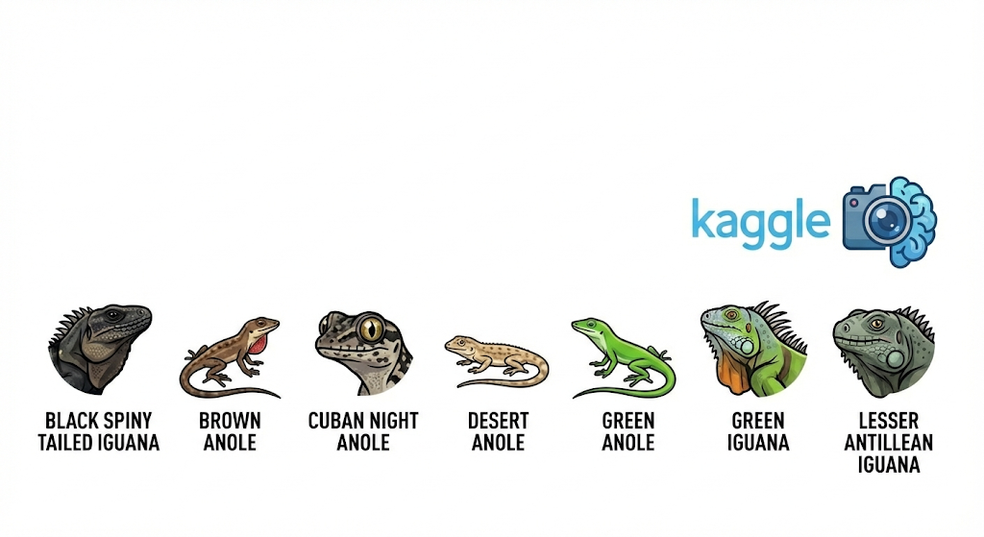
Deep Learning Lizard Challenge – 30% of total grade
Minimum Requirements:
Use of Jupyter notebook with markdown cells to add structure and documentation (upload to Canvas)
Perform EDA on the data
Design & train your own model in Keras / TensorFlow (no Pytorch or others)
Use of transfer learning & data augmentation techniques
Plotting of the training process (including validation set)
Evaluation of the model, including a confusion matrix
Valid Kaggle submission
Powerpoint presentation for your team defense (upload to Canvas)
Possible Extra’s:
Higher score on Kaggle
General expansion on the implementations of the minimum requirements
Use of learning rate schedules, use of TensorBoard (or WandB) to visualize training, etc.

Slide 4

Team Defense of Challenge
Upload notebook as a report, and the powerpoint, to Canvas before deadline
Each team will get their own timeslot to defend
Explain the result of the challenge in 10min. to instructor, using powerpoint
How did you tackle the challenge? What insights did you get from the EDA? What problems did you encounter when modelling? What results did you get?
Did everybody in the team contribute an equal amount?
Conceptual questions will be asked regarding the topics covered in the challenge
Individual adjustments of the score can be made, depending on the weekly follow-ups in class, answering of questions, work done, etc.

Slide 5



GenAI Policy
Provide a paragraph (markdown block) at the end of each assignment, explaining
What you used the AI tool for
What prompts you used to get the results
Acknowledge the limitations and uncertainties of the outputs.
Make sure you understand the output yourself!

Slide 6
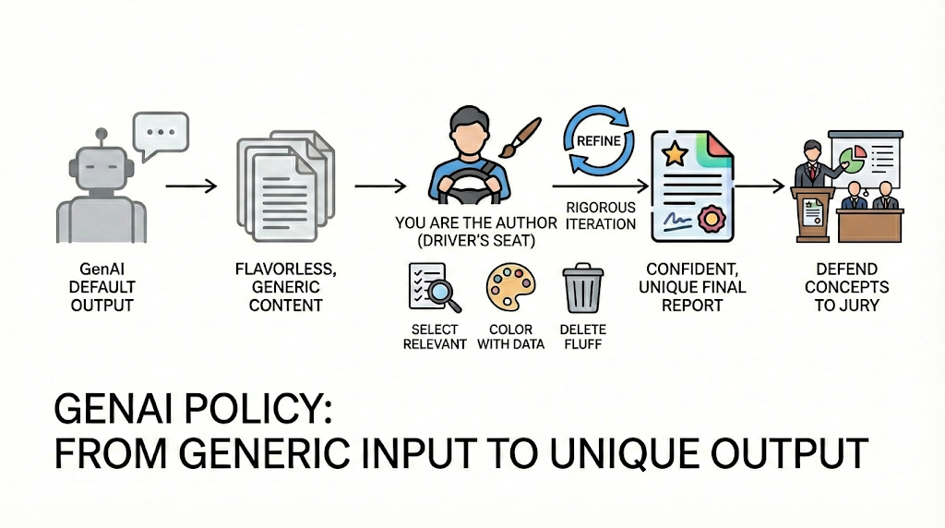
Notes:
GenAI policy
When using GenAI for report writing, it is important to remember that these tools are designed to provide an answer for every section you request—even if those details aren't truly relevant to your specific project. Because GenAI works by predicting the "most likely" next word, its default output is often "flavorless" and "grey"—a blend of common patterns that lacks the unique spark of your own insight. To avoid a bland, generic report, you must treat GenAI as an input tool for inspiration and brainstorming, never as the final output tool. You are the author; it is your responsibility to take ownership by selecting only the relevant pieces, "coloring them in" with your specific project data, and making the active choices that give your work its flavor. This process isn't a one-click solution; it requires rigorous iteration. You must stay in the driver's seat by using follow-up prompts to refine ideas, deleting the "fluff," and constantly steering the tool until the final result is something you can confidently stand behind.

Slide 7


Join Kaggle in class competition
Invite link:
https://www.kaggle.com/t/c84b4cada54949fa92507da14455a8da
Make sure you register with your school email
Teams of 3 → instructor will check next lesson, and note down the teams

